Slide 1
Summarising data
Task A: Calculating all of the averages
1) Complete the information showing the mean, median, and mode for the following datasets.
a)
1 | 1 | 1 | 3 | 7 | 10
mean | 3.83 | median |  | mode
b)
14 | 23 | 24 | 25 | 27 | 27 | 28
mean |  | median |  | mode | 27
b)
2.5 | 3.5 | 4 | 5.5 | 7 | 7 | 8.5 | 8.5
mean |  | median | 6.25 | mode
2) Calculate the mean, median, and mode of these three datasets.
a)
2.5 | 2.5 | 4 | 9 | 10.5
mean |  | median |  | mode
b)
15 | 18 | 20 | 20 | 23 | 24
mean |  | median |  | mode
b)
4 | 4 | 4 | 5 | 7 | 7 | 7 | 8 | 8
mean |  | median |  | mode
3) For question 2, which of the datasets was the odd one out? Justify your answer.

Slide 2
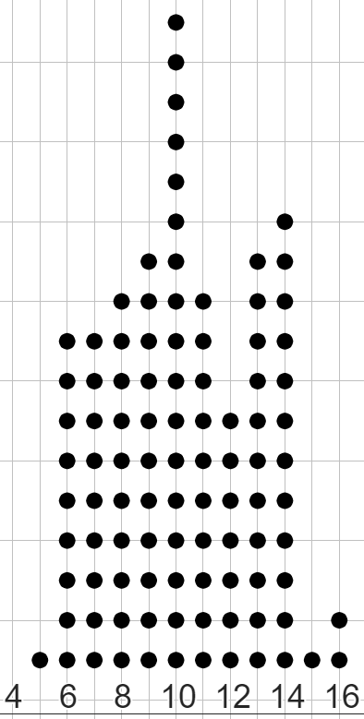
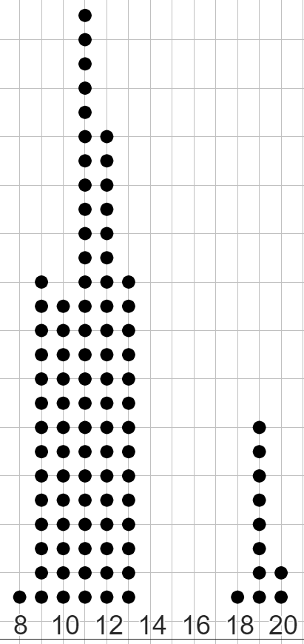
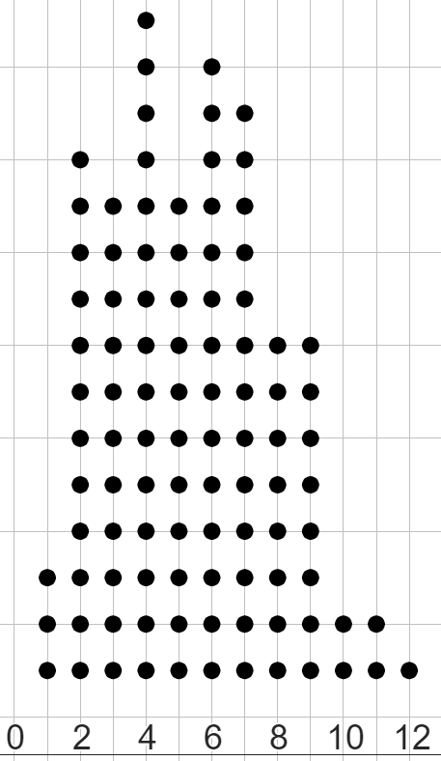
Summarising data
Task B: Dealing with an unrepresentative mean
1) Match the mean to each dataset.
mean = −3
a)
2 | 2 | 2 | 4 | 6 | 7 | 7 | 9 | 15
b)
−4 | −3 | −3 | −3 | −1 | 2 | 3 | 3 | 6
mean = 0
c)
6 | 7 | 7 | 8 | 10 | 10 | 32 | 32
mean = 6
mean = 14
2)
a) Calculate the mean of this dataset.
b) Explain whether the mean is a representative summary of the dataset or not.
11 | 11 | 11 | 49 | 51 | 51 | 51 | 51 | 51 | 53
a)
b)
c)
3) Match the mean to each dot plot.
mean = 5.3
mean = 10.2
mean = 11.9
mean = 17.1

Slide 3
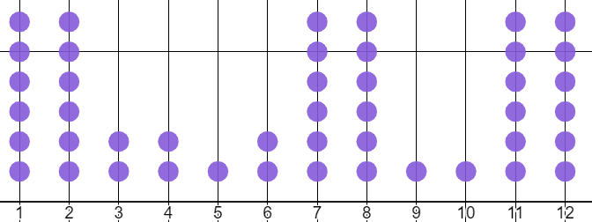
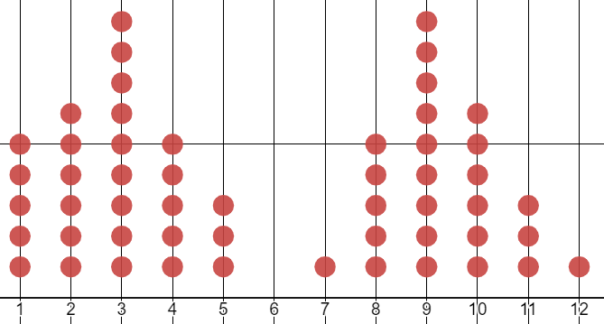
Summarising data
Task C: Dealing with an unrepresentative median or mode
1) For which one of these datasets is the median the more representative summary, and for which one is the mode the more representative summary?
You must write one sentence why you chose that one over the other.
median = 7
median = 6
2) Answer parts a, b, and c for both these datasets.
dataset 1
1 | 2 | 3 | 3 | 3 | 3 | 3 | 3 | 3 | 3 | 4 | 6 | 9 | 57
dataset 2
2 | 2 | 2 | 3 | 4 | 4 | 4 | 5 | 5 | 6 | 6 | 6 | 8
a) Calculate the mean, median, and mode for this dataset.
b) Which averages do you think are the most representative summaries of this dataset?
c) What benefit might there be to still using the average that is least representative?
Mathematics in Education and Industry.

